Slide 1
Fasciolopsis buski
Common Name: The large or giant intestinal fluke.
DR SOWMYA R.S.G
DEPT OF PATHOLOGY AND MICROBIOLOGY
SKHMC

Slide 2
Geographical Distribution.
It is an Asiatic trematode and has been reported from China, Thailand and Malaysia, Bengal, Assam and other Oriental regions.

Slide 3
Habitat.
The adult worm lives in the small intestine of man and pig. The normal host is the pig which serves as the reservoir of infection for man.

Slide 4
Morphology
Adult Worm.
It is the largest trematode parasitising man and measures 2 to 7.5 cm in length, 8 to 20 mm in breadth and 0.5 to 3 mm in thickness.

Slide 5
It is elongated and oval in shape, the anterior being narrower than the posterior.
The acetabulum is large and lies close to the oral sucker.
Life Span of Adult worm is Short ( not more than 6 months)

Slide 6
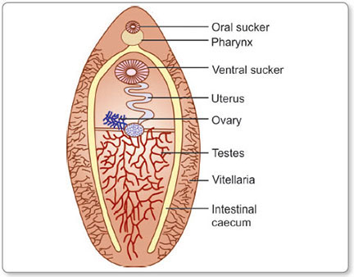

Slide 7
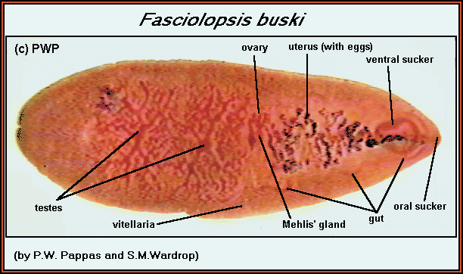

Slide 9
EGGS : Same as F. hepatica, Each worm lays 25,000 eggs /day

Slide 10
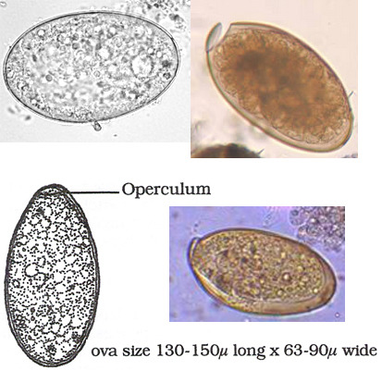

Slide 11
Life Cycle.
TWO different hosts are required
Definitive Hosts. Man and pig. Adult worms are found in the small intestine.
Intermediate Host. Small flatly coiled aquatic snails of the genus Segmentina.
The life cycle is the same as that described for F. hepatica.

Slide 12
The cercariae, on coming out of the snail, encyst on fresh-water plants, especially seed pods of water-caltrop, the bulb of water-chestnut and other aquatic vegetations which are fertilised with night-soil and are grown in shallow ponds where the snails abound.

Slide 13
On being swallowed, the metacercariae excyst in the duodenum and the liberated young worms attaches to the intestinal wall and developed into adult worm about 3 months. The eggs are then liberated and the cycle is repeated.

Slide 14
Pathogenicity
Mode of Infection. Eating infected plants as raw foodstuff (peeling it with the teeth).
Portal of Entry. Alimentary canal.
Infecting Agent. Encysted cercariae (metacercariae).
Site of Localisation. Small intestine (duodenum and jejunum).

Slide 15
Infection with F. buski is known as fasciolopsiasis. The disease is characterised by asthenia, mild anaemia and chronic diarrhoea.

Slide 16
In heavy infections, anaemia becomes more intense and absorption of by-products of the worm leads to oedema and eosinophilia:
Paralytic ileus is a rare complication

Slide 17
Diagnosis
Stool Examination - Egg in Stool
Eosinophilia present
Serodiagnosis – no value

